Slide 1
Basic Statistics

Slide 2
Agenda – Basic Statistics
1
Data Types – Continuous, Discrete, Nominal, Ordinal, Interval, Ratio, Random Variable, Probability, Probability Distribution
2
First, second, third & fourth moment business decisions
3
Graphical representation – Bar plot, Histogram, Boxplot, Scatter diagram
4
Hypothesis Testing
5
Simple Linear Regression

Slide 3
STATISTICS
Statistics is the science of data. It involves
collecting,
classifying,
summarizing,
analyzing,
and interpreting numerical information.
Statistics is used in several different disciplines (both scientific
and non-scientific) to make decisions and draw conclusions based on data.

Slide 4



Software for the Course

Slide 5
ENTIRE POPULATION
SAMPLE
SAMPLE
SAMPLE WITHIN
(subset)
POPULATION
Sample Statistics
A sample is a set of n observations actually
obtained and a statistic is a numerical value
that describes the sample.
X = Sample Mean
s² = Sample Variance
s = Sample Standard Deviation
Population Parameters
a hypothetical set of N observations from
which the sample is obtained (typically N
very large)
μ = Population mean
σ² = Population Variance
σ = Population Standard Deviation

Slide 6
STATISTICS
There are two types of statistics that are often referred to when making a statistical decision or working on a statistical problem.
Descriptive Statistics : Descriptive statistics utilize numerical and graphical methods to look for patterns in a data set, to summarize the information revealed in a data set, and to present the information in a convenient form that individuals can use to make decisions. The main goal of descriptive statistics is to describe a data set. Thus, the class of descriptive statistics includes both numerical measures (e.g. the mean or the median) and graphical displays of data
(e.g. pie charts or bar graphs).
Inferential Statistics: Inferential statistics utilizes sample data to make estimates, decisions, predictions, or other generalizations about a larger set of data. Some examples of inferential statistics might be a z statistics or a t-statistics

Slide 7
STATISTICS
Inferential Statistics
The main goal of inferential statistics is to make a conclusion about a population based off of a sample of data from that population. One of the most commonly used inferential techniques is hypothesis testing
Ex: New drug tests

Slide 8
Primary & Secondary Data
Primary:
Primary data is the kind of data that is collected directly from the data source without going through any existing sources. It is mostly collected specially for a research project and may be shared publicly to be used for other research
Primary data is often reliable, authentic, and objective in as much as it was collected with the purpose of addressing a particular research problem. It is noteworthy that primary data is not commonly collected because of the high cost of implementation.
Secondary:
Secondary data is the data that has been collected in the past by someone else but made available for others to use. They are usually once primary data but become secondary when used by a third party.
Secondary data are usually easily accessible to researchers and individuals because they are mostly shared publicly. This, however, means that the data are usually general and not tailored specifically to meet the researcher's needs as primary data does.

Slide 9
Level of Measurement
To perform statistical analysis of data, it is important to first understand variables and what should be measured using these variables. There are different levels of measurement in statistics and data measured using them can be broadly classified into qualitative and quantitative data.
First, let’s understand what a variable is. A quantity whose value changes across the population and can be measured is called variable. For instance, consider a sample of employed individuals. The variables for this set of the population can be industry, location, gender, age, skills, job-type, etc. The value of the variables will differ with each employee.
For example, it is practically impossible to calculate the average hourly rate of a worker in the US. So, a sample audience is randomly selected such it represents the larger population appropriately. Then the average hourly rate of this sample audience is calculated. Using statistical tests, you can conclude the average hourly rate of a larger population.

Slide 10
Levels of Measurement Scales
Nominal:
Nominal scale is a naming scale, where variables are simply “named” or labeled, with no specific order
Ordinal
Ordinal scale has all its variables in a specific order, beyond just naming them
Interval
Interval scale offers labels, order, as well as, a specific interval between each of its variable options.
Ratio
Ratio scale bears all the characteristics of an interval scale, in addition to that, it can also accommodate the value of “zero” on any of its variables.

Slide 11
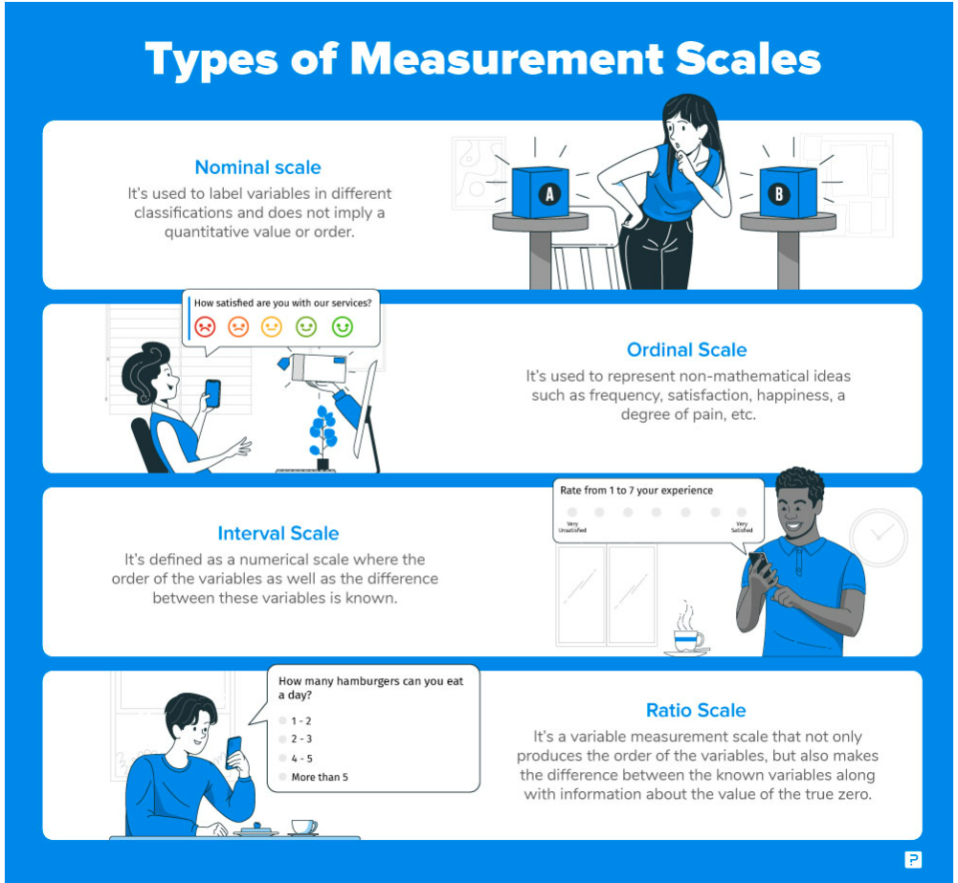

Slide 12
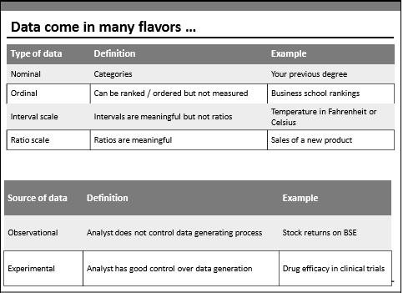
Notes:
Here’s the problem with interval scales: they don’t have a “true zero.” For example, there is no such thing as “no temperature.” Without a true zero, it is impossible to compute ratios. With interval data, we can add and subtract, but cannot multiply or divide. Confused? Ok, consider this: 10 degrees + 10 degrees = 20 degrees. No problem there. 20 degrees is not twice as hot as 10 degrees, however, because there is no such thing as “no temperature” when it comes to the Celsius scale.

Slide 13
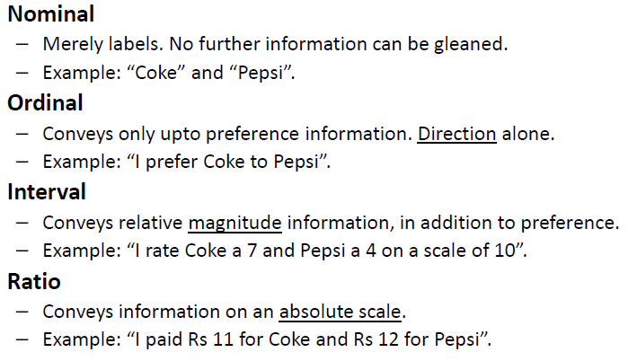
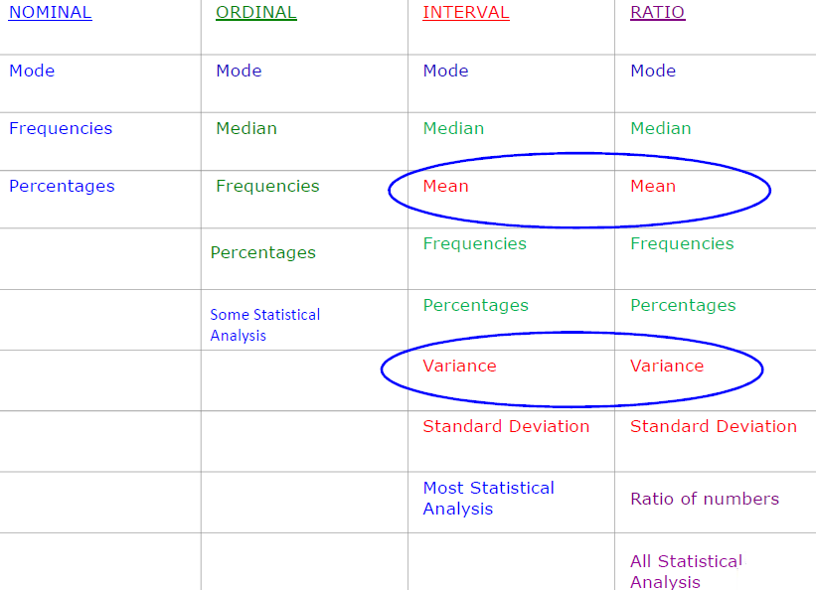
Data Types – Preliminaries
Notes:
Interval data always appears in the form of numbers or numerical values where the distance between the two points is standardized and equal.
Interval data cannot be multiplied or divided, however, it can be added or subtracted

Slide 14


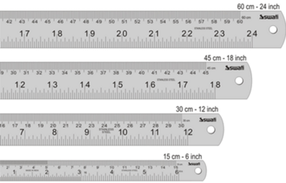



Data Types – Continuous & Discrete

Slide 15
Group the following as either discrete or continuous data.
Speed of a car
Volume of a cereal box
Population of a town
Length of a crocodile
# Shirts
Discrete? Continuous?
Number of goals in a season
Temperature of oven
Number of matches in a box

Slide 16
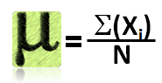
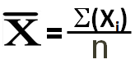



Measures of Central Tendency
Central Tendency | Population | Sample
Mean / Average
Median | Middle value of the data
Mode | Most occurring value in the data
“Every American should have above average income, and my Administration is going to see they get it.” – American President

Slide 17
Sample Mean for a Distribution
Σ y means, “Add up all the Y's”
For a discrete function
_
N
^
μ = Σ x_{i} /N
= X₁ + X₂ +....X_{N}
N
X=
i=1
Examples:
Coating weights: 8.47, 8.67, 9.34, 7.99
Coating AVERAGE = 8.47 +8.67 + 9.34 + 7.99 = 8.62
4
Batting Performance: 0, 0, 1, 0, 1 (0= no hit, 1=hit)
BATTING AVERAGE = 0+ 0 +1 +0 + 1 = 0.400
5
Mean = Average

Slide 18
Sample Median
Assume that x1, x2, …xn is a list of sample data sorted in ascending order.
Then…
X =
~
middle value, if n is odd
the average of the two middle values, if n is even
{
Find the sample mean and median for the two data sets below:
X: Data Set 1 : 10, 12, 11, 14, 11, 13, 12, 14, 16, 13
X = X =
Y: Data Set 2: 10, 12, 11, 14, 11, 13, 12, 14, 44, 13
Y = Y =
~
~

Slide 19
Mode
The modal value of a set of data is the most frequently occurring value.
Find the mode for: 2, 6, 3, 9, 5, 6, 2, 6
It can be seen that the most frequently occurring value is 6. (There are 3 of these)
Bi model and Multi model
Mode for:
1,2,3,3,3,4,4,4,5,6,7
2,2,3,10,11,17,3,10

Slide 20
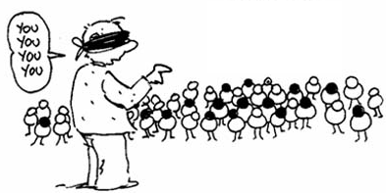
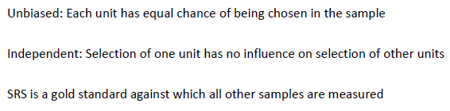
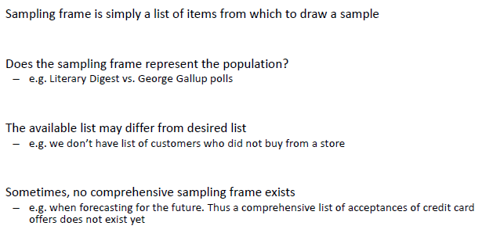
Simple Random Sampling
Sampling Frame
Notes:
A Normal distribution is an important statistical data distribution pattern occurring in many natural phenomena, such as height, blood pressure, lengths of objects produced by machines, etc. Certain data, when graphed as a histogram( data on the horizontal axis, amount of data on the vertical axis), creates a bell shaped curve known as a normal curve, or normal distribution.
Normal distribution is symmetrical with a single central peak at the mean (average) of the data. The shape of the curve is described as bell-shaped with the graph falling off evenly on either side of the mean. Fifty percent of the distribution lies to the left of the mean and fifty percent lies to the right of the mean.

Slide 21
Sampling Funnel
Population
Sampling Frame
SRS
Sample

Slide 22
Measures of Variability
The mean, mode, and median do a nice job in telling where the center of the data set is, but often we are interested in more…
For example, a pharmaceutical engineer develops a new drug that regulates sugar in the blood.
Suppose she finds out that the average sugar content after taking the medication is the optimal level.
This does not mean that the drug is effective. There is a possibility that half of the patients have dangerously low sugar content while the other half has dangerously high content.
Instead of the drug being an effective regulator, it is a deadly poison.
What the pharmacist needs is a measure of how far the data is spread apart. This is what the variance and standard deviation do
Notes:
Normal blood sugar levels are less than 100 mg/dL after not eating (fasting) for at least eight hours. And they're less than 140 mg/dL two hours after eating.

Slide 23
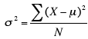
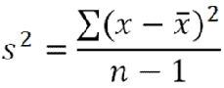
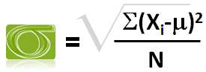
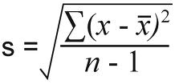
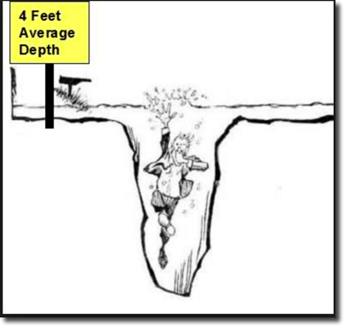
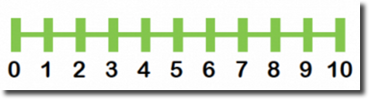
Measures of Dispersion
Dispersion | Population | Sample
Variance
Standard Deviation
Range | Max – Min

Slide 24
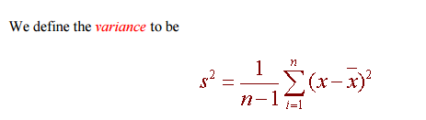
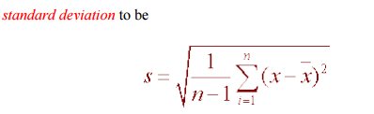

Slide 25
Computing step by step
Variance and Standard Deviation: Step by Step
Calculate the mean, x.
Write a table that subtracts the mean from each observed value.
Square each of the differences.
Add this column.
Divide by n -1 where n is the number of items in the sample This is the variance.
To get the standard deviation we take the square root of the variance.

Slide 26
Measures of Variability
Deviation is the distance from the mean.
Deviation score = observation - true mean
Variance = mean or average of squared deviation scores.
.
Standard Deviation = square root of variance.
μ
= Population Mean
i
Deviation (distance from mean)

Slide 27
In class exercise
Find std and Var
44, 50, 38, 96, 42, 47, 40, 39, 46, 50

Slide 28
Range
The "Range" for a data set is the difference between the largest value and smallest value contained in the data set. First reorder the data set from smallest to largest then subtract the first element from the last element
Data Set = 2, 5, 9, 3, 5, 4, 7
Reordered = 2, 3, 4, 5, 5, 7, 9
Range = ( 9 - 2 ) = 7

Slide 29
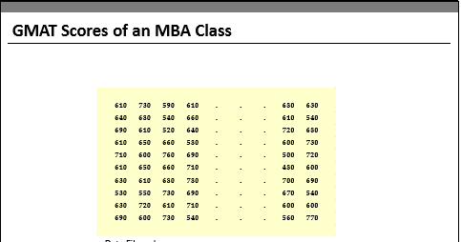
Visualization Techniques

Slide 30
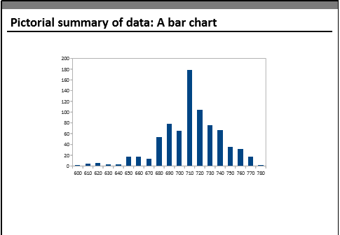

Slide 31
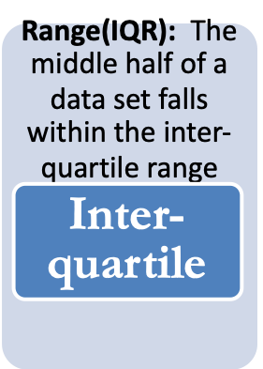
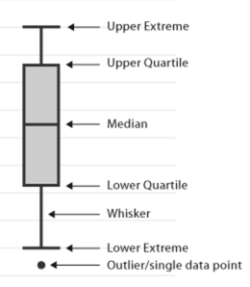

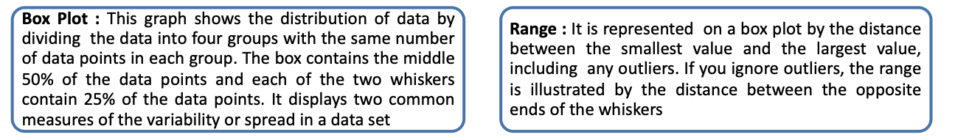
Graphical Techniques – Box Plot

Slide 32
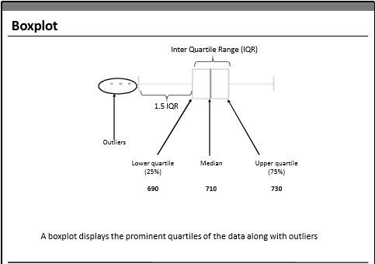

Slide 33
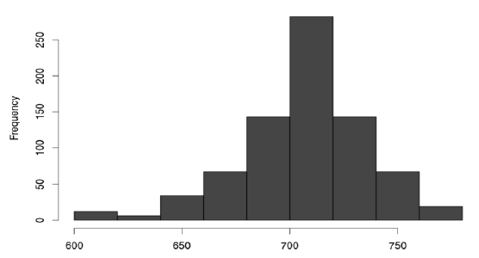
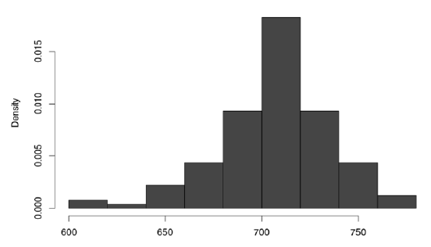
Graphical Techniques – Histogram
A Histogram Represents the frequency distribution, i.e., how many observations take the value within a certain interval.

Slide 34
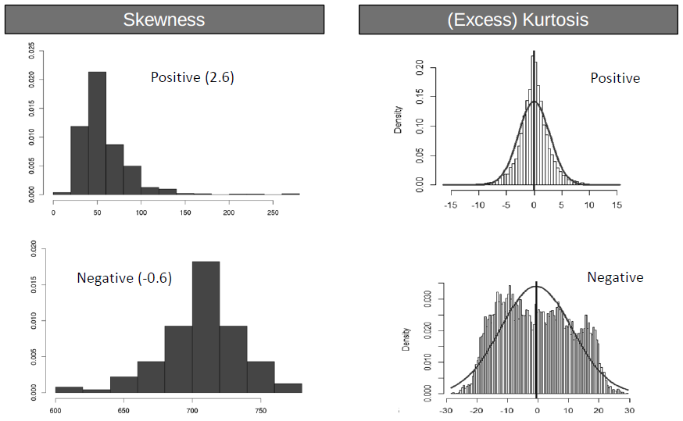
Skewness & Kurtosis
Third and Fourth moments
Skewness Kurtosis
A measure of asymmetry in the distribution
Mathematically it is given by
E[(x-µ/σ)]³
Negative skewness implies mass of the
distribution is concentrated on the
right
A measure of the “Peakedness” of
the distribution
Mathematically it is given by
E[(x-µ/σ)]⁴ -3
For Symmetric distributions, negative
kurtosis implies wider peak and thinner
tails

Slide 35
Random Variable & Probability

Slide 36
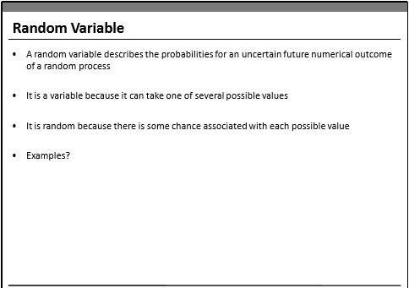

Slide 37
Discrete Random Variables : Random variables that can assume a countable number of values. If a random variable can only take a finite
number of distinct values, it must be discrete
Ex : number of defective light bulbs in a box, the number of children in a family
Continuous Random Variables: Random variables that can assume any value corresponding to any of the points contained in one or more intervals They are usually measurements. Things like heights, weights, and time are continuous random variables
Ex: time it takes to complete a race or the length of time between arrivals at a hospital clinic.

Slide 38
Probability Distributions
Continuous Probability Distributions
Discrete Probability Distribution

Slide 39
Probability Distributions
Discrete Probability Distribution: The probability distribution of a discrete random variable is a graph, table or formula that specifies the probability associated with each possible value the random variable can assume.
Discrete Probability distribution properties:
• The sum of all probabilities in a distribution sum to 1.
• Each value has a probability between 0 and 1.

Slide 40
Discrete probability Distribution:
Binomial Distribution
A binomial experiment is a statistical experiment that has the following properties:
The experiment consists of n repeated trials.
Each trial can result in just two possible outcomes. We call one of these outcomes
a success and the other, a failure ; Yes or No
The probability of success, denoted by P, is the same on every trial.
The trials are independent; that is, the outcome on one trial does not affect the
outcome on other trials.

Slide 41
Example : Binomial Distribution
Consider the following statistical experiment.
You flip a coin 2 times and count the number of times the coin lands on heads.
This is a binomial experiment because:

Slide 42
Example : Binomial Distribution
The experiment should consists of n repeated trials.
The experiment consists of repeated trials. We flip a coin 2 times.
Each trial can result in just two possible outcomes
Each trial can result in just two possible outcomes - heads or tails.
The probability of success, denoted by P, is the same on every trial
The probability of success is constant - 0.5 on every trial.
The trials are independent; that is, the outcome on one trial does not affect the
outcome on other trials.
The trials are independent; that is, getting heads on one trial does not affect whether we get heads on other trials.

Slide 43
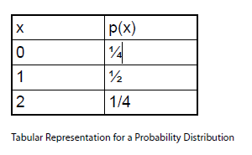
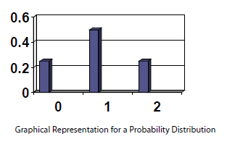
Binomial Distribution
A binomial random variable is the number of successes x in n repeated trials of a binomial experiment.
The probability distribution of a binomial random variable is called a binomial distribution
Suppose we flip a coin and count the number of heads (successes).
The binomial random variable is the number of heads,
which can take on values of 0, 1, or 2. The binomial distribution is presented below.

Slide 44
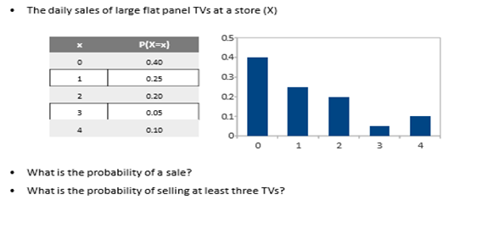
In class exercise:
Probability Calculation for discrete P.D

Slide 45
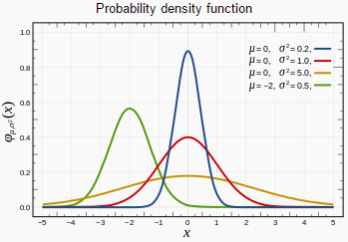
Continuous Probability Distributions
Continuous Probability Distribution: We can describe the probability distribution of a continuous random variable using a probability density function. A probability density function f(x) is a function that you can use to find the
probabilities of a continuous variable across a range of values. It tells us
what the shape of the probability distribution is.
Probability is all about how likely things are to happen, and the frequency tells you how often values occur. The higher the relative frequency, the higher the probability of that value occurring

Slide 46
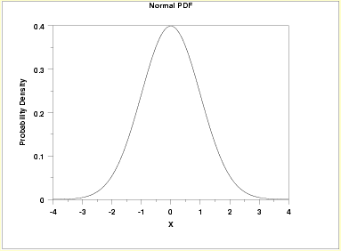
Normal Distribution
It is one of the most famous statistical distributions in use .The normal distribution is a continuous probability distribution Several phenomenon are modelled with the normal distribution.
For example : Heights of people are normally distributed as well as possible blood pressure levels for people.

Slide 47
Normal Distribution
The Properties of the Normal Distribution:
A continuous random variable X has a normal distribution if its values fall into a smooth curve that is bell shaped.
• Every normal distribution has its own mean (denoted μ) and its own standard deviation (denoted σ). The normal distribution is defined by its mean and standard deviation.
• Its shape of the normal distribution is symmetric around the mean.
• The mean, median, and the mode of a normal distribution are equal.
• The area under the curve is 1.
• Normal distributions are denser in the center and less so in the tails.
• Since the normal distribution is mound shaped, it follows the empirical rule i.e.
i) 68% of the area of a normal distribution is within one standard deviation of the mean;
ii) 95% of the data are within 2 standard deviations of the mean;
iii) 99.7% of the data are within 3 standard deviations of the mean.

Slide 48
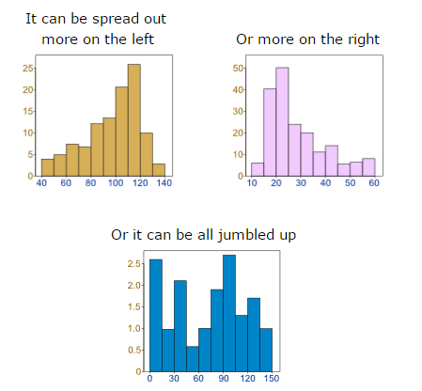
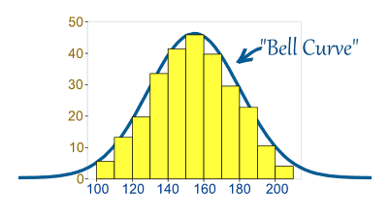
Normal Distribution
But there are many cases where the data tends to be around a central value with no bias left or right, and it gets close to a "Normal Distribution" like this
Data can be "distributed" (spread out) in different ways.
Sample(1:10000,100)

Slide 49
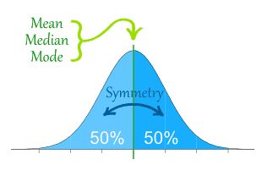
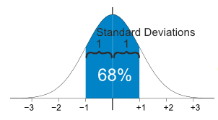
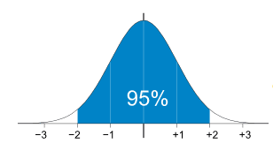
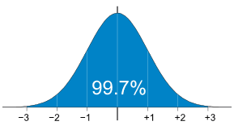
Normal Distribution
The Normal Distribution has
mean = median = mode
Symmetry about the center
50% of values less than the mean and 50% greater than the mean
95% of values are within 2 standard deviations of the mean
99.7% of values are within 3 standard deviations of the mean
68% of values are within 1 standard deviation of the mean

Slide 50
Z- Scores
z-score makes use of the mean and the standard deviation of the data set in order to specify the relative location of a measurement.
It represents the distance between a given data point and the mean, expressed in standard deviations. The score is also known as “standardizing” the data point
Large z-scores tell us that the measurement is larger than almost all other measurements in the data set.
Similarly, a small z-score tells us that the measurement is small than all other measurements.
If a score is 0, then the observation lies on the mean.

Slide 51
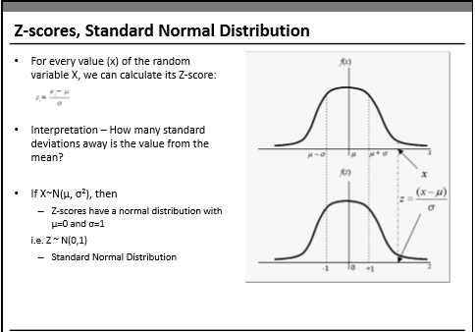
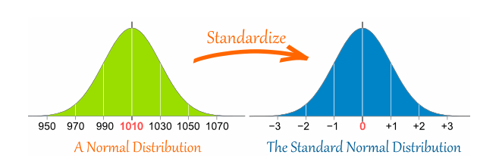

Slide 52
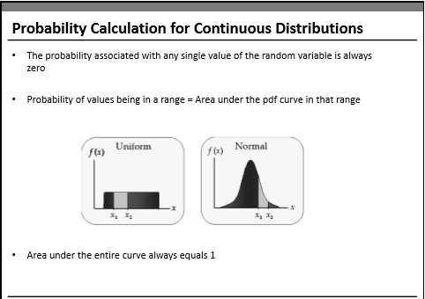


Slide 53
Probability calculation for Normal Distribution
Consider normally distributed random variable X~N(mu,sigma^2)
To compute probability P(X<=x)
from SciPy import stats
stats.norm.cdf( x, loc=mean, scale=std), by def it would consider X<=32
1- stats.norm.cdf( x, loc=mean, scale=std), for greater than 32, use Area under the curve
1. X: It is the random variable.
2. loc: It is the location parameter of the distribution. It is mean for normal distribution.
3. scale: It is the scale parameter of the distribution. It is standard deviation for normal distribution.

Slide 54
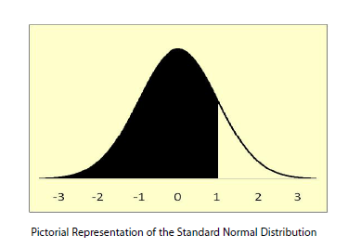
Calculating Probabilities : Normal distribution
Ex: find the probability that a normally distributed random variable has
a mean of 60 and a standard deviation of 10 and we want to find the probability that X is less than 70.
from SciPy import stats
stats.norm.cdf( x, loc=mean, scale=std)

Slide 55
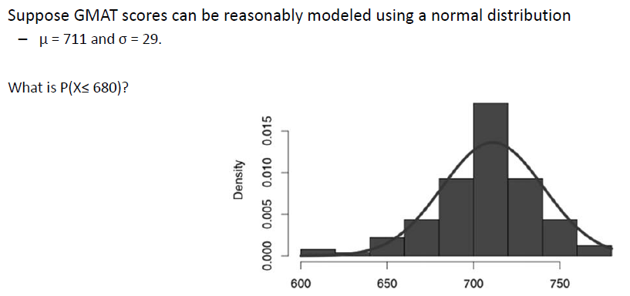
In class exercise

Slide 56
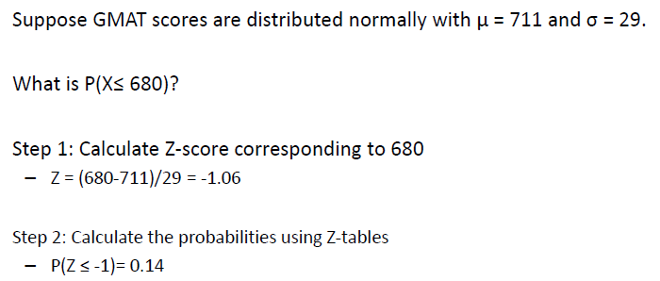
Exercise

Slide 57
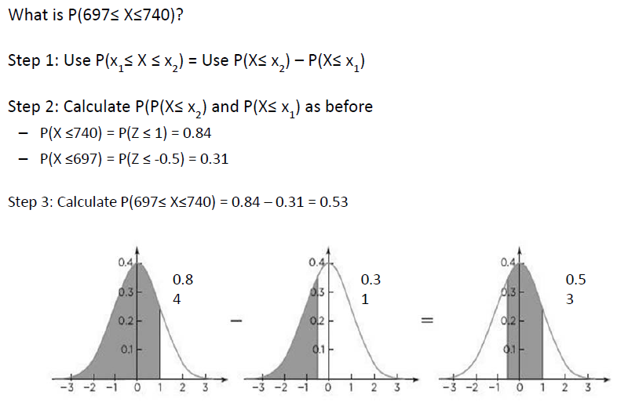
Exercise

Slide 58
Normal Distribution Example and Application

Slide 59
Stock Price
To understand normal distribution and its application, Let us use daily returns of stocks traded in BSE (Bombay Stock Exchange). Imagine a scenario where an investor wants to understand the risks and returns associated with various stocks before investing in them.
For this analysis, we will evaluate two stocks: BEML and GLAXO. The daily trading data (open and close price) for each stock is taken for the period starting from 2010 to 2016 from BSE site (www.bseindia.com)

Slide 60
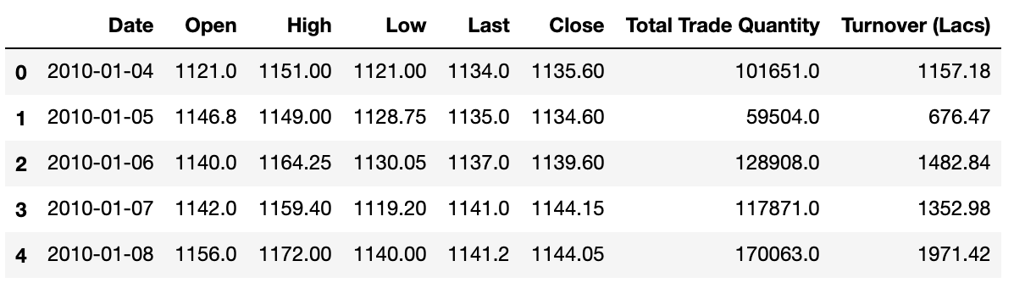
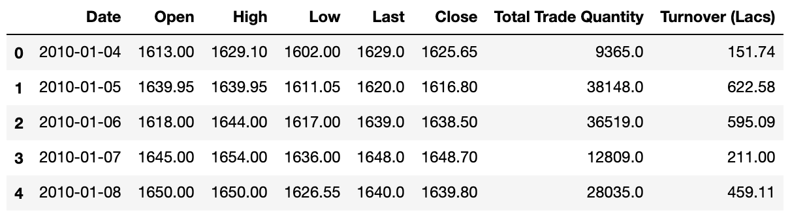
Data
BEML
The dataset contains
daily Open and Close price along with daily High and Low prices, Total Trade
Quantity, and Turnover (Lacs).
Our discussion will involve only close price. The daily returns of a stock are calculated as the change in close prices with respect to the close price of yesterday.
GLAXO

Slide 61
What questions can be answered?
1.What is the expected daily rate of return of these stocks?
2. Which stocks have higher risk or volatility as far as daily returns are concerned?
3. Which stock has higher probability of making a daily return of 2% or more?
4. Which stock has higher probability of making a loss (risk) of 2% or more?

Slide 62
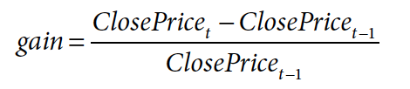
To answer the above questions, we must find out the behavior of daily returns (we will refer to this as gain hence forward) on these stocks. The gain can be calculated as a percentage change in close price, from the
previous day’s close price
The method pct_change() in Pandas will give the percentage change in a column value shifted by a period, which is passed as a parameter to periods

Slide 63
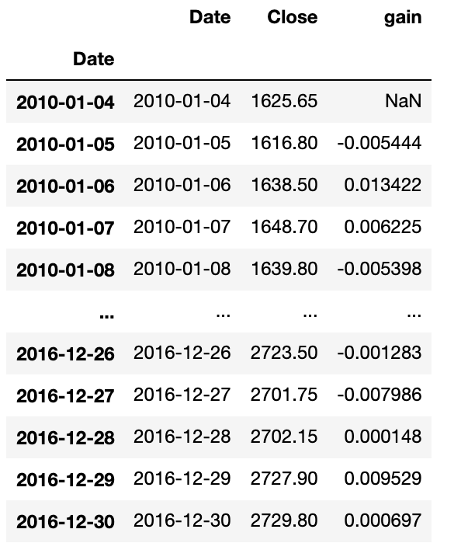


Slide 64

Mean and Variance
Glaxo :
Mean: 0.0004
Standard Deviation: 0.0134
BEML:
Mean: 0.0003
Standard Deviation: 0.0264
Gain seems to be normally distributed for both the stocks with a mean around 0.00.
BEML seems to have a higher variance than Glaxo
Note: This distribution has a long tail, but we will assume normal distribution for simplicity and discuss the example

Slide 65
The expected daily rate of return (gain) is around 0% for both stocks.
Here variance or standard deviation of gain indicates risk.
So, BEML stock has a higher risk as standard deviation of BEML is 2.64% whereas the standard deviation for Glaxo is 1.33%.

Slide 66
To calculate the probability of gain higher than 2% or more, we need to find out what is the sum of all probabilities that gain can take values more than 0.02 (i.e., 2%).
Probability of making
2% loss or higher in Glaxo: 0.063 or 6.3%
Probability of making
2% loss or higher in BEML: 0.2215 or 22.3%
Probability of making
2% gain or higher in Glaxo: 0.0710 or 7.1%
Probability of making
2% gain or higher in BEML: 0.2276 or 22.76%

Slide 67




Normal Distribution codes

Slide 68




Student’ t- Distribution codes

Slide 69
Inferential Statistics

Slide 70


Inferential Statistics
Notes:
A Normal distribution is an important statistical data distribution pattern occurring in many natural phenomena, such as height, blood pressure, lengths of objects produced by machines, etc. Certain data, when graphed as a histogram( data on the horizontal axis, amount of data on the vertical axis), creates a bell shaped curve known as a normal curve, or normal distribution.
Normal distribution is symmetrical with a single central peak at the mean (average) of the data. The shape of the curve is described as bell-shaped with the graph falling off evenly on either side of the mean. Fifty percent of the distribution lies to the left of the mean and fifty percent lies to the right of the mean.

Slide 71




Sampling – How can it go wrong
Sampling variation
Notes:
A Normal distribution is an important statistical data distribution pattern occurring in many natural phenomena, such as height, blood pressure, lengths of objects produced by machines, etc. Certain data, when graphed as a histogram( data on the horizontal axis, amount of data on the vertical axis), creates a bell shaped curve known as a normal curve, or normal distribution.
Normal distribution is symmetrical with a single central peak at the mean (average) of the data. The shape of the curve is described as bell-shaped with the graph falling off evenly on either side of the mean. Fifty percent of the distribution lies to the left of the mean and fifty percent lies to the right of the mean.

Slide 72
STATISTICS
There are two types of statistics that are often referred to when making a statistical decision or working on a statistical problem.
Descriptive Statistics : Descriptive statistics utilize numerical and graphical methods to look for patterns in a data set, to summarize the information revealed in a data set, and to present the information in a convenient form that individuals can use to make decisions. The main goal of descriptive statistics is to describe a data set. Thus, the class of descriptive statistics includes both numerical measures (e.g. the mean or the median) and graphical displays of data
(e.g. pie charts or bar graphs).
Inferential Statistics: Inferential statistics utilizes sample data to make estimates, decisions, predictions, or other generalizations about a larger set of data. Some examples of inferential statistics might be a z statistics or a t-statistics

Slide 73



Central Limit Theorem
Thumb rule to check whether CLT can be applied
Notes:
A Normal distribution is an important statistical data distribution pattern occurring in many natural phenomena, such as height, blood pressure, lengths of objects produced by machines, etc. Certain data, when graphed as a histogram( data on the horizontal axis, amount of data on the vertical axis), creates a bell shaped curve known as a normal curve, or normal distribution.
Normal distribution is symmetrical with a single central peak at the mean (average) of the data. The shape of the curve is described as bell-shaped with the graph falling off evenly on either side of the mean. Fifty percent of the distribution lies to the left of the mean and fifty percent lies to the right of the mean.

Slide 74

Confidence Intervals

Slide 75
Confidence Interval
What is the Probability of tomorrow’s temperature being 42 degrees exactly ?
Probability is ‘0’
Can it be between [-50⁰C & 100⁰C] ?
Notes:
A Normal distribution is an important statistical data distribution pattern occurring in many natural phenomena, such as height, blood pressure, lengths of objects produced by machines, etc. Certain data, when graphed as a histogram( data on the horizontal axis, amount of data on the vertical axis), creates a bell shaped curve known as a normal curve, or normal distribution.
Normal distribution is symmetrical with a single central peak at the mean (average) of the data. The shape of the curve is described as bell-shaped with the graph falling off evenly on either side of the mean. Fifty percent of the distribution lies to the left of the mean and fifty percent lies to the right of the mean.

Slide 76
Confidence Intervals
Sometimes samples don’t give quite the right result
Point estimators are valuable, but they may give
errors
Because we’re not dealing with the entire population, all we’re doing
is giving a best estimate. If the sample we use is unbiased, then the
estimate is likely to be close to the true value of the population
Specify a Range instead of single pint of estimate

Slide 77

Credit card

Slide 78
Interval estimates of parameters
Based on sample data
− Can we trust this estimate ?
What do you think will happen if we took another random sample of 140 alumni ?
Because of this uncertainty, we prefer to provide the estimate as an interval (range) and associate a level of confidence with it
− The point estimate for mean balance = $1990
Interval Estimate =
Point Estimate ± Margin of Error
Thumb rule to check whether CLT can be applied
Notes:
A Normal distribution is an important statistical data distribution pattern occurring in many natural phenomena, such as height, blood pressure, lengths of objects produced by machines, etc. Certain data, when graphed as a histogram( data on the horizontal axis, amount of data on the vertical axis), creates a bell shaped curve known as a normal curve, or normal distribution.
Normal distribution is symmetrical with a single central peak at the mean (average) of the data. The shape of the curve is described as bell-shaped with the graph falling off evenly on either side of the mean. Fifty percent of the distribution lies to the left of the mean and fifty percent lies to the right of the mean.

Slide 79


Slide 80


from scipy import stats
stats.norm.ppf(.975)

Slide 81


Slide 82


Slide 83


Slide 84


Slide 85


Slide 86

from scipy import stats
stats.t.ppf(0.975,df=139)

Slide 87
Let us find CIs for the
BEML and Glaxo gains

Slide 88
Anova and Chi square Test

Slide 89

Anova
Analysis of Variance( ANOVA ) is a statistical technique which is used to check if the means of two or more groups are statistically different from each other.
It checks the impact of one or more factors by comparing the means of different samples.

Slide 90

Terminologies used
Grand Mean: it is the average of sample means
Hypothesis: Ho: Ho: μ1 = μ2 = μ3
Ha: At least one mean is different
Variation between groups: For each data point look at the difference between its group mean and the overall mean
Variation Within Groups: Difference between data point and its sample mean

Slide 91

Example
A research institute wants to determine the best diet plan for weight loss and for this they have randomly selected 36 volunteers to analyze three diet plans ( Atkins , GM , South beach ) .Help the research institute in identifying the best diet plan by analyzing the weight lost by the volunteers.

Slide 92

Calculations

Slide 93
Calculations
Deviation of mean with global Mean: (μ1 – μ)²
SS between group : product of Deviation of global mean with local mean and no. of data points
SS within group(Residual): total squared deviation of data points with its local mean
Sum of Squares Total: SS within group + SS between Group
F-ratio = ( SS Btwn Groups / DF )
(SS With Groups / DF)

Slide 94


Slide 95
Conclusion
If calculated F ratio is greater than F value based on the degrees of freedom ,we reject Ho .

Slide 96
Chi-Square test
Chi-square tests of independence test whether two qualitative variables are independent, that is, whether there exists a relationship between two categorical variables
Hypotheses
The Chi-square test of independence is a hypothesis test so it has a null (H0) and an alternative hypothesis (H1):
H0 : the variables are independent, there is no relationship between the two categorical variables. Knowing the value of one variable does not help to predict the value of the other variable
H1 : the variables are dependent, there is a relationship between the two categorical variables. Knowing the value of one variable helps to predict the value of the other variable

Slide 97

Chi-Square test
The chi-square test is used when the data is categorical and it detects the difference between observed data and what could we expect if the Ho is true.
O: Observed Frequency in the data for each type
E: Expected Frequency to see of each type if the null hypothesis was true.

Slide 98
How the test works
If the difference between the observed frequencies and the expected frequencies is small, we cannot reject the null hypothesis of independence and thus we cannot reject the fact that the two variables are not related
if the difference between the observed frequencies and the expected frequencies is large, we can reject the null hypothesis of independence and thus we can conclude that the two variables are related How the test works

Slide 99

we want to determine whether there is a statistically significant association between smoking and being a professional athlete.
Smoking can only be “yes” or “no” and being a professional athlete can only be “yes” or “no”. The two variables of interest are qualitative variables, so we need to use a Chi-square test of independence, and the data have been collected on 28 persons

Slide 100

O: Observed Frequency in the data for each type
E: Expected Frequency to see of each type if the null hypothesis was true.

Slide 101


Test statistic
and then we sum them all to obtain the test statistic:
χ2=2.78+5+2.78+5=15.56

Slide 102

Critical value
df=(number of rows−1)⋅(number of columns−1)
Chi-square table (α=0.05 and df=1) : The critical value is 3.84146
test statistic=15.56>critical value=3.84146
Like for any statistical test, when the test statistic is larger than the
critical value, we can reject the null hypothesis at the
specified significance level

Slide 103
Hypothesis Testing

Slide 104
What is hypothesis testing ?
Hypothesis testing is a statistical method that is used in making statistical decisions using experimental data. Hypothesis Testing is basically an assumption that we make about the population parameter.
Ex : You say avg height of citizens of city is more than 5.8 ft.
Votes for the politician will be more than 60%
All those example we assume need some statistic way to prove those. we need some mathematical conclusion what ever we are assuming is true.

Slide 105
Example
It is claimed that a process has been improved in yield by bringing a change in an important factor X. Yield data are collected from old and new processes.
Random samples are drawn from yield data from old process A and improved process B.
Process A Process B
89.7 | 84.7
81.4 | 86.1
84.5 | 83.2
84.8 | 91.9
87.3 | 86.3
79.7 | 79.3
85.1 | 82.6
81.7 | 89.1
83.7 | 83.7
84.5 | 88.5
“Is there real difference between Process A and Process B?”

Slide 106
Example: Hypothesis Testing
Real Question:
Can we say that the yield of improved Process B is greater than old Process A?
Descriptive Statistics
Variable | Process | N | Mean | Std. Dev.
Yield | A | 10 | 84.24 | 2.90
 | B | 10 | 85.54 | 3.65
Statistical Question:
Is there a statistically significant difference between mean of Process B (85.54) and mean of Process A (84.24)? Or, is this difference in mean just due to chance?

Slide 107
Hypothesis Testing
Develop the hypothesis for population and make statistical decision by determining the acceptance of hypothesis using sample data.
Example: Medicine B for treating headache that is newly developed by a pharmaceutical company has 30 minutes longer effect than existing Medicine A.
Null Hypothesis (H0): Argument made so far, or hypothesis saying that there is no change or difference
Alternative Hypothesis (H1): New argument, that is a hypothesis that you want to prove with solid ground obtained from sample
H0 : Medicine A and B have same effect
H1 : Medicine B has 30 minutes longer effect than Medicine A
Notes:
Lawyer judge, Angelina jolie

Slide 108
Procedure of Hypothesis Testing
The steps for hypothesis tests are as follows:
1. Define null and alternative hypotheses.
2. Identify the test statistic to be used for testing the validity of the null hypothesis, for example, Z-test or t-test.
3. Decide the significance value (Alpha). Typical value used for a is 0.05.
4. Calculate the p-value (probability value), which is the conditional probability of observing the
test statistic value when the null hypothesis is true. We will use the functions provided in scipy.stats module for calculating the p-value.
5. Take the decision to reject or retain the null hypothesis based on the p-value and the significance
value a.

Slide 109


Procedure of Hypothesis Testing

Slide 110

1-tail, 2-Tail
1-Sample, 2-Sample

Slide 111


Slide 112

from scipy import stats
stats.norm.cdf(z)
stats.t.cdf(t,df=10)

Slide 113


Slide 114

Notes:
The p-value is the probability that the t-statistic observed by chance under the assumption that NULL hypothesis is true.

Slide 115
Normal Distribution codes

Slide 116
Student’ t- Distribution codes

Slide 117
Simple Exercise
Conducting a hypothesis test is a bit like putting accused person on trial in front of a jury.
The jury assumes that the accused person is innocent unless there is strong evidence against him, but even after considering the evidence,
it’s still possible for the jury to make wrong decisions

Slide 118

Simple Exercise
A accused person is on trial for a crime, and you’re on the jury. The jury’s
task is to assume the prisoner is innocent, but if there’s enough
evidence against him, they need to convict him.
In the trial, what’s the null hypothesis?
What’s the alternate hypothesis?
In what ways can the jury make a verdict that’s correct?
In what ways can the jury make a verdict that’s incorrect?

Slide 119
Simple Exercise
In the trial, what’s the null hypothesis?
The null hypothesis is that the prisoner is innocent, as that is what we have to assume until there’s proof otherwise.
What’s the alternate hypothesis?
The alternate hypothesis is that the prisoner is guilty. In other words, if there’s sufficient proof that the prisoner is not innocent, then we’ll accept that he’s guilty and convict him.

Slide 120
Simple Exercise
In what ways can the jury make a verdict that’s correct?
We can make a correct verdict if:
a) The prisoner is innocent, and we find him innocent.
b) The prisoner is guilty, and we find him guilty.
In what ways can the jury make a verdict that’s incorrect?
We can make an incorrect verdict if:
a) The prisoner is innocent, and we find him guilty.
b) The prisoner is guilty, and we find him innocent.

Slide 121
The errors we can make when conducting a hypothesis test are the same sort of errors we could make when putting a prisoner on trial
Hypothesis tests are basically tests where you take a claim and put it on trial by assessing the evidence against it. If there’s sufficient evidence against it, you reject it, but if there’s insufficient evidence against it, you accept it.
You may correctly accept or reject the null hypothesis, but even considering the evidence, it’s also possible to make an error. You may reject a valid null hypothesis, or you might accept it when it’s actually false

Slide 122
Statisticians have special names for these types of errors.
A Type I error is :
when you wrongly reject a true null hypothesis (Punished a innocent guy), and
A Type II error is :
when you wrongly accept a false null hypothesis (Let guilty go free).

Slide 123

ERRORS
Actual Situation

Slide 124


Slide 125


Slide 126
Let us solve the problem
Mean =4.0
Standard deviation =3
Sample Size =50
Sample mean =4.6
import scipy
import numpy as np
T statistic = (4-4.6)/(3/np.sqrt(50))
2*stats.t.cdf(-1.41,df=49)

Slide 127


Slide 128


Slide 129
Let us do it in Python
scipy.stats.ttest_1samp(array,mu)

Slide 130
One-sample and one tail t-tests
Ex. An outbreak of Salmonella-related illness was attributed to ice cream produced at a certain factory. Scientists measured the level of Salmonella in 9 randomly sampled batches of ice cream. The levels (in MPN/g) were
0.593, 0.142, 0.329, 0.691, 0.231, 0.793, 0.519, 0.392, 0.418
Is there evidence that the mean level of Salmonella in the ice cream is greater than 0.3 MPN/g?
Let us try in Python

Slide 131
Let be the mean level of Salmonella in all batches of ice cream. Here the hypothesis of interest can be expressed as:
H0: <= 0.3
Ha: > 0.3
Data = pd.Series([0.593, 0.142, 0.329, 0.691, 0.231, 0.793, 0.519, 0.392, 0.418])
scipy.stats.ttest_1samp(data,0.3)

Slide 132
Two-sample t-tests
Ex. 6 subjects were given a drug (treatment group) and an additional 6 subjects a placebo (control group). Their reaction time to a stimulus was measured (in ms). We want to perform a two-sample t-test for comparing the means of the treatment and control groups.
Control : 91, 87, 99, 77, 88, 91
Treat :101, 110, 103, 93, 99, 104

Slide 133
Let Mu1 be the mean of the population taking medicine and Mu2 the mean of the untreated population. Here the hypothesis of interest can be expressed as:
H0: Mu1-Mu2=0
Ha: Mu1-Mu2 !=0
Control=pd.Series([91, 87, 99, 77, 88, 91])
Treat =pd.Series([101, 110, 103, 93, 99, 104])
stats.ttest_ind( control,Treat)
Ttest_indResult(statistic=-3.445612673536487, pvalue=0.006272124350809803)

Slide 134
2 Proportion t test

Slide 135
Usecase : Is there a significant difference between the population proportions of state 1 and state 2 who report that they have been placed immediately after education?
Populations: All Students who have completed graduation and Post graduation in both Use case states Parameter of Interest: p1 — p2, where p1 = state1 and p2 = state2
Data: 247 students from state 1. 36.8% of students report that they have got the job.
308 students from state 2. 38.9% of students report that they have got the job.
Hypothesis Definition:
Null Hypothesis: p1 - p2 = 0 Alternative Hypothesis: p1 -p2 ≠ 0

Slide 136
The difference in population proportion needs t-test. Also, the population follows a binomial distribution here. We can just pass on the two population quantities with the appropriate binomial distribution parameters to the t-test function
We can use the ttest_ind() function from Statsmodels.
The function returns three values: (a) test statistic, (b) p-value of the t-test, and (c) degrees of freedom used in the t-test
Data Given:
n1 = 247 p1 = .37 n2 = 308 p2 = .39

Slide 137
Exploratory Data Analysis-1 (EDA-1)
Data Cleaning,
Imputation Techniques,
Data Analysis and Visualization(Scatter Diagram, Correlation Analysis),
Transformations
Auto EDA libraries

Slide 138
Exploratory Data Analysis-1 (EDA-1)
Data Cleaning,
Imputation Techniques,
Data Analysis and Visualization(Scatter Diagram, Correlation Analysis),
Transformations
Auto EDA libraries

Slide 139
EDA
1) Describe a dataset: Number of rows/columns, missing data, data types, preview.
2) Clean data : Handle missing data, invalid data types, incorrect values and outliers
3) Visualize data distributions: Bar charts, histograms, box plots.
4) Calculate and visualize: Correlations (relationships) between variables, Heat map

Slide 140
Data Cleaning

Slide 141
Data Cleaning
Data cleaning or cleansing is the process of detecting and correcting (or removing) corrupt or inaccurate records from a record set, table, or database and refers to identifying incomplete, incorrect, inaccurate or irrelevant parts of the data and then replacing, modifying, or deleting the dirty or coarse data.
Data Quality:
Validity,
Accuracy,
Completeness,
Consistency,
Uniformity.

Slide 142
Validity
Data-Type Constraints: values in a particular column must be of a particular datatype, e.g., boolean, numeric, date, etc.
Range Constraints: typically, numbers or dates should fall within a certain range.
Mandatory Constraints: certain columns cannot be empty.
Set-Membership constraints: values of a column come from a set of discrete values,. For example, Blood Groups – Fixed set of discrete values

Slide 143
Validity
Regular expression patterns: text fields that have to be in a certain pattern. For example, phone numbers may be required to have the pattern (999) 999–9999.
Cross-field validation: certain conditions that span across multiple fields must hold. For example, a patient’s date of discharge from the hospital cannot be earlier than the date of admission.

Slide 144
Accuracy
The degree to which the data is close to the true values.
While defining all possible valid values allows invalid values to be easily spotted, it does not mean that they are accurate.
A valid street address mightn’t actually exist.
Another thing to note is the difference between accuracy and precision. Saying that you live on the earth is, actually true. But, not precise. Where on the earth?. Saying that you live at a particular street address is more precise.

Slide 145
Consistency and Uniformity
The degree to which the data is consistent, within the same data set or across multiple data sets.
Inconsistency occurs when two values in the data set contradict each other.
A valid age, say 3, mightn’t match with the marital status, say divorced.
A customer is recorded in two different tables with two different Genders.
Which one is true?.
The degree to which the data is specified using the same unit of measure.
The weight may be recorded either in pounds or kilos. The date might follow the USA format or European format. The currency is sometimes in USD and sometimes in Euros.
And so data must be converted to a single measure unit.

Slide 146
Outliers
Outliers are data that is distinctively different from other observations. They could be real outliers or mistakes.
How to find out?
Depending on whether the feature is numeric or categorical, we can use different techniques to study its distribution to detect outliers.

Slide 147


Outliers
Histogram/Box Plot:
When the feature is numeric, we can use a histogram and box plot to detect outliers.
From Histogram, if the data is highly skewed then there is a possibility of outliers and confirm with the boxplot

Slide 148

Outliers
Descriptive Statistics:
Also, for numeric features, the outliers could be too distinctive. We can look at their descriptive statistics.
For example, for the feature Ozone, we can see that the maximum value is 168, while the 75% quartile is only 68. The 168 value could be an outlier.

Slide 149


Outliers
Bar Chart:
When the feature is categorical. We can use a bar chart to learn about its categories and distribution.
For example, the feature Month has a reasonable distribution except for category 2 .
2nd Month column has only one value , this can be an outlier.
2

Slide 150
Outliers
What to do?
While outliers are not hard to detect, we have to determine the right solutions to handle them. It highly depends on the dataset and the goal of the project.
The methods of handling outliers are somewhat similar to missing data. We either drop or adjust or keep them. We can refer to the missing data section for possible solutions.

Slide 151
Data Cleaning Steps
Duplicate rows
Rename the columns
Drop unnecessary columns
Convert data types to other types
Remove strings in columns
Change the data types
Outliers

Slide 152
Refer ipython notebook for data cleaning steps

Slide 153
Missing Values:
Detection
Treatment

Slide 154

What is missing value
Some of the values will be missed in the data set because of
various reasons such as human error, machine failures etc

Slide 155

Missing Values: How to find?
Missing Data Heatmap:
When there is a smaller number of features, we can visualize the missing data via heatmap.
The horizontal axis shows the feature name; the vertical axis shows the number of observations/rows; the yellow colour represents the missing data while the blue colour otherwise.

Slide 156
Treat missing values
Drop the Observation
In statistics, this method is called the listwise deletion technique. In this solution, we drop the entire observation if it contains a missing value.
Only if we are sure that the missing data is not informative, we perform this. Otherwise, we should consider other solutions

Slide 157
Treat missing values :Impute the Missing
When the feature is a numeric variable, we can conduct missing data imputation. We replace the missing values with the average or median value from the data of the same feature that is not missing
data_cleaned3['Ozone'] = data_cleaned3['Ozone'].fillna(med)
For categorical values :
df = df.fillna(df.mode().iloc[0])

Slide 158
Treat missing values
df.method() | description
dropna() | Drop missing observations
dropna(how='all') | Drop observations where all cells is NA
dropna(axis=1, how='all') | Drop column if all the values are missing
dropna(thresh = 5) | Drop rows that contain less than 5 non-missing values
fillna(0) | Replace missing values with zeros
isnull() | returns True if the value is missing
notnull() | Returns True for non-missing values

Slide 159
Refer ipython notebook for Missing values treatment

Slide 160
Scatter Plot

Slide 161

Scatter Plot
A scatter plot (aka scatter chart, scatter graph) uses dots to represent values for two different numeric variables. Scatter plots are used to observe relationships between variables.
Temperature °C | Ice Cream Sales
14.2° | $215
16.4° | $325
11.9° | $185
15.2° | $332
18.5° | $406
22.1° | $522
19.4° | $412
25.1° | $614
23.4° | $544
18.1° | $421
22.6° | $445
17.2° | $408
Which variable affects which one?

Slide 162
Scatter Plot
Cigarettes (X) in Years | Lung Capacity (Y)
0 | 45
5 | 42
10 | 33
15 | 31
20 | 29

Slide 163
Correlation

Slide 164

Pearson Correlation
Correlation is a bi-variate analysis that measures the strength of linear association between two variables and the direction of the relationship. Correlation is a statistical technique used to determine the degree to which two variables are linearly related.
[ -1 ….. 0 ….. +1 ]
High correlation
Low correlation
High correlation

Slide 165
Correlation r - Interpretation
Positive r indicates positive linear association between x and y or variables, and negative r indicates negative linear relationship
r – always between -1 and +1
The strength increases as r moves away from zero toward wither -1 or +1
The extreme values +1 and -1 indicate perfect linear relationship (points lie exactly along a straight line)
Graded interpretation : r 0.1-0.3 = weak; 0.4-0.7 = moderate and 0.8-1.0=strong correlation

Slide 166


Correlation

Slide 167

Correlation

Slide 168

Source: https://en.wikipedia.org/wiki/Correlation_and_dependence
Non-linear association will be covered in EDA - 2

Slide 169
Scatter Plot and Correlation : Smoking and Lung Capacity
Example: investigate relationship between cigarette smoking and lung capacity
Data: sample group response data on smoking habits, and measured lung capacities, respectively

Slide 170

Smoking v Lung Capacity Data
N | Cigarettes (X ) | Lung Capacity (Y )
1 | 0 | 45
2 | 5 | 42
3 | 10 | 33
4 | 15 | 31
5 | 20 | 29
-0.96 implies almost certainty smoker will have diminish lung capacity

Slide 171
Transformations
Dummy Variable Feature Scaling

Slide 172


Dummy variables
Categorical variables have to be converted to numerical using a method called One-hot encoding
OHE : Pandas, sklearn
Pd.get_dummies(df)
sklearn.OneHotEncoding

Slide 173


Feature scaling
Some machine learning algorithms are sensitive to feature scaling means results will vary based on the units of the features so remove of the effect of scaling, it is required to go for feature scaling
Standardization
Standardization is scaling technique where the values are cantered around the mean with a unit standard deviation.
Normalization
Normalization is a scaling technique in which values are shifted and rescaled so that they end up ranging between 0 and 1. It is also known as Min-Max scaling

Slide 174
Automatic EDA methods
Exploratory data analysis (EDA) is an essential early step in most data science projects and it often consists of taking the same steps to characterize a dataset (e.g. find out data types, missing information, distribution of values, correlations, etc.).
Given the repetitiveness and similarity of such tasks, there are a few libraries that automate and help speed up the process
Libraries:
pandas_profiling
sweetviz

